Slide 1

Pizza Sales Analysis Report

Slide 2
About Project
This project analyzes pizza sales data using SQL to uncover insights such as the most popular pizza sizes, top-selling pizza types, revenue distribution, and ordering patterns. The goal is to provide actionable insights to enhance business decisions and optimize sales strategies.

Slide 3


Total Orders Purpose : Retrieve the total number of orders placed
Query :
Findings :

Slide 4
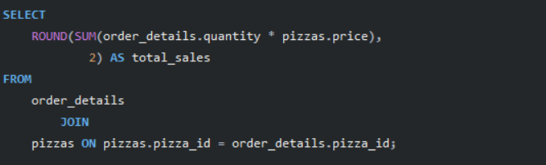

Total Revenue Purpose : Calculate the total revenue generated from pizza sales
Query :
Findings :

Slide 5
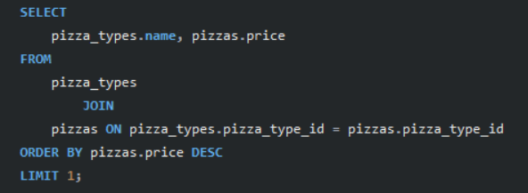

Highest Price Pizza Purpose : Identify the highest-priced pizza
Query :
Findings :

Slide 6
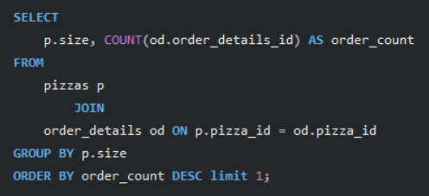

Most Common Pizza Size Purpose : Identify the most common pizza size ordered
Query :
Findings :

Slide 7
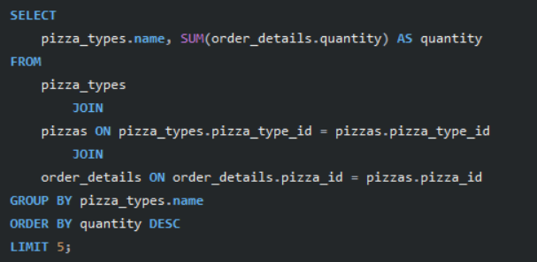
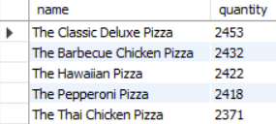
Top Five Most Ordered Pizza Types Purpose : List the top 5 most ordered pizza types along with their quantities
Query :
Findings :

Slide 8
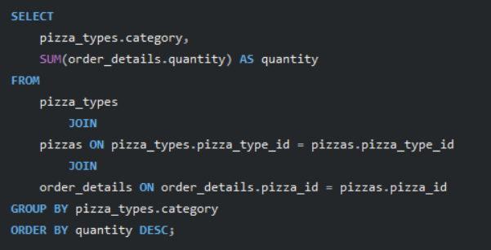
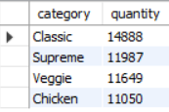
Total Quantity By Pizza Category Purpose : Join the necessary tables to find the total quantity of each pizza Category Ordered
Query :
Findings :

Slide 9
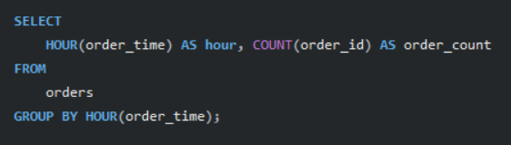
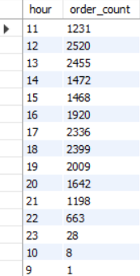
Order Distribution by Hour Purpose : Determine the distribution of orders by hour of the day
Query :
Findings :

Slide 10

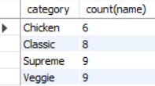
Category-wise Distribution of Pizzas Purpose : Join relevant tables to find the category-wise distribution of pizzas
Query :
Findings :

Slide 11
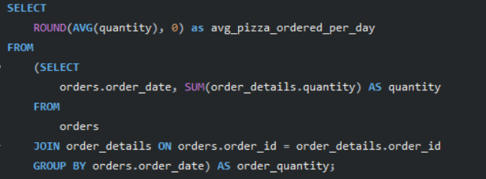

Average Pizzas Ordered Per Day Purpose : Group the orders by date and calculate the average number of pizzas ordered per day
Query :
Findings :

Slide 12
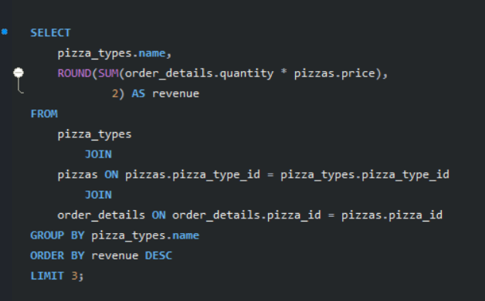

Top 3 Most Ordered Pizzas by Revenue Purpose : Determine the top 3 most ordered pizza types based on revenue
Query :
Findings :

Slide 13
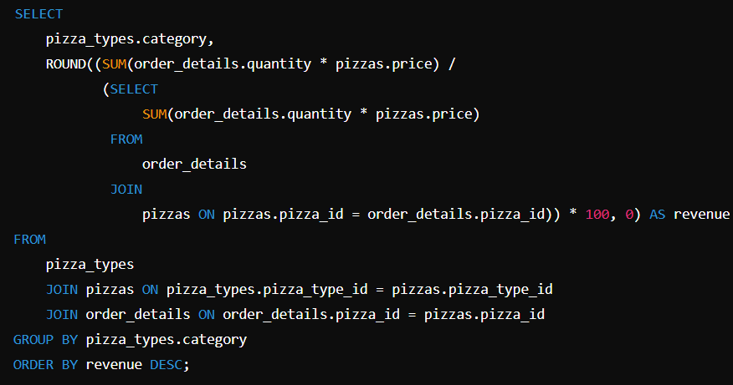
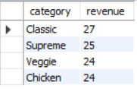
Percentage Contribution to Total Revenue Purpose : Calculate the percentage contribution of each pizza type to total revenue
Query :
Findings :

Slide 14
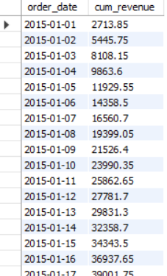
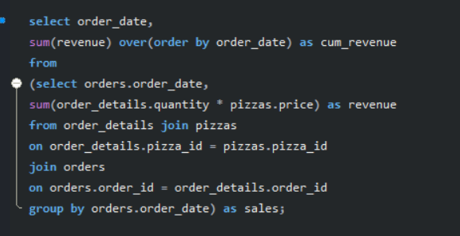
Cumulative Revenue Over Time Purpose : Analyze the cumulative revenue generated over time
Query :
Findings :

Slide 15
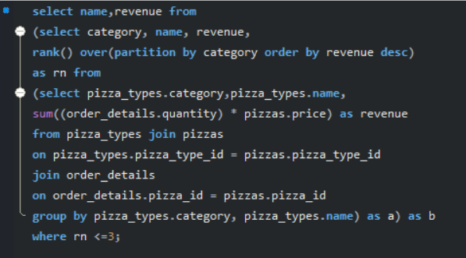
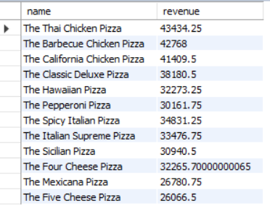
Top 3 Most Ordered Pizza Types by Category Purpose : Determine the top 3 most ordered pizza types based on revenue for each pizza category
Query :
Findings :

Slide 16
Thank you
Ruchith Kapoor
4379732103
ruchithkapoor@gmail.com

